Slide 1
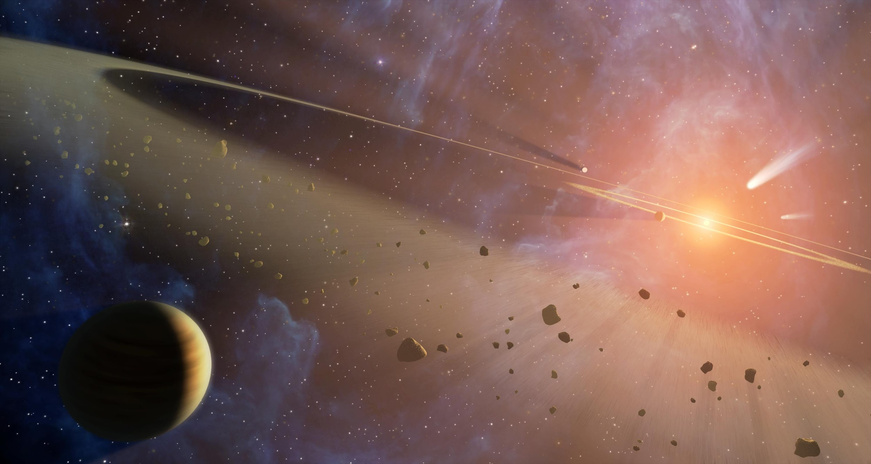
Group 2: Effect of wavelengths and spectral type on light curves
Proposed acronyms:
E-WASP
EEW - STYLE
Emmanuel Joliet, Ben Yelverton, Harriet Brettle, Tim Banks, Juan Carlos Beamin, Jessica Spake, Maximilian N. Günther, Anthony Harness, Michael Lund, Kyra Dame
https://github.com/lundmb/Sagan2016

Slide 2
Project Goal - How does transit shape change with wavelength?
We will consider the following:
Using the 1D stellar spectra as a function of time, derive a white-light (summed over all wavelength) light curve (as a function of time)
Estimate the depth of the transit
Given that the transit depth is (R_{p}/R*)², roughly estimate the planet radius (using the stellar spectrum as a guide for the stellar type/size)
The combinations of stellar types and planets that might give a similar transit depth
Describe why small stars (M dwarfs) make advantageous host stars
Create light curves for spectral resolutions (R ~ λ/Δ λ) of roughly 10 and 100
Investigate how the transit shape/depth changes as a function of wavelength
Consider at which wavelengths the limb-darkening effect is strongest
Notes:
We are considering the following questions in turn.

Slide 3
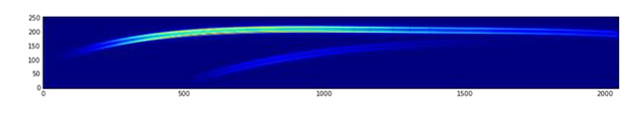
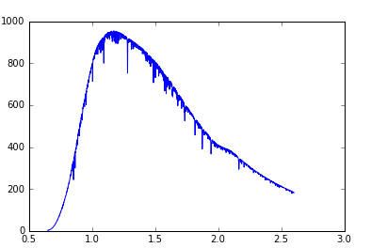
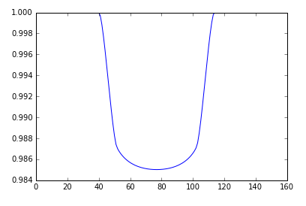
1. Using the 1D stellar spectra as a function of time, we derived a white-light light curve (as a function of time)
Inputs from JWST……
2D SOSS trace images as a function of time
White-light transit curve (summed over all wavelengths)
countrate
wavelength
To do your own… http://maestria.astro.umontreal.ca/niriss/simu1D/simu1D.php

Slide 4
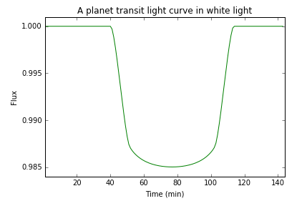
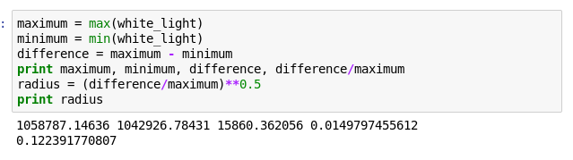
2. We then estimate the depth of the transit
We can observe that this is a 1.5% flux transit event
(R_{p}/R*)² = 0.015
R_{p} = 0.12 R*
Frame

Slide 5
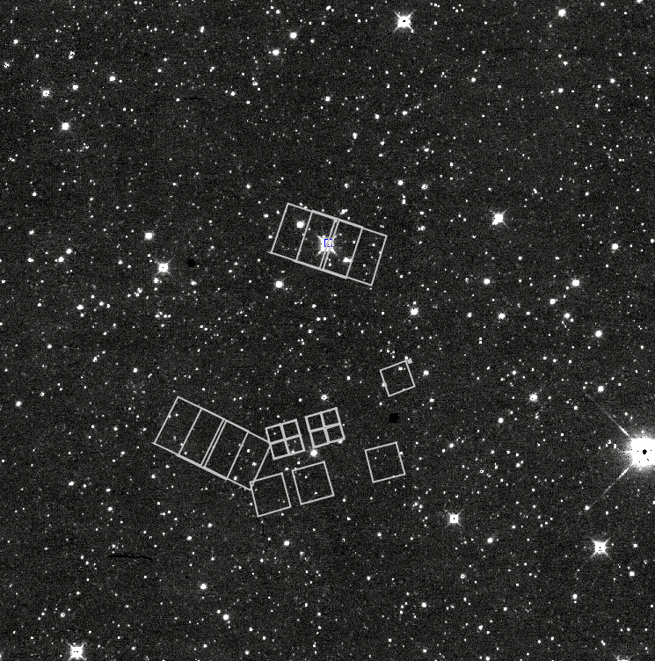
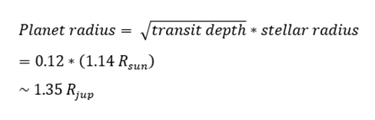
3. Given that the transit depth is (R_{p}/R*)², we estimate the planet radius
Using the stellar spectrum as a guide for the stellar type/size:
Stellar type = G0V (HD 209458b)
Stellar radius = 1.14 Rsun
JWST/NIRSPEC instrument aperture footprint on
HD 209458 b region [Osiris, +22 03 10.8 +18 53 04]
NIRSPEC
JWST
IRSA/WISE/L1/w1 (~ 0.7ºx0.7º)

Slide 6
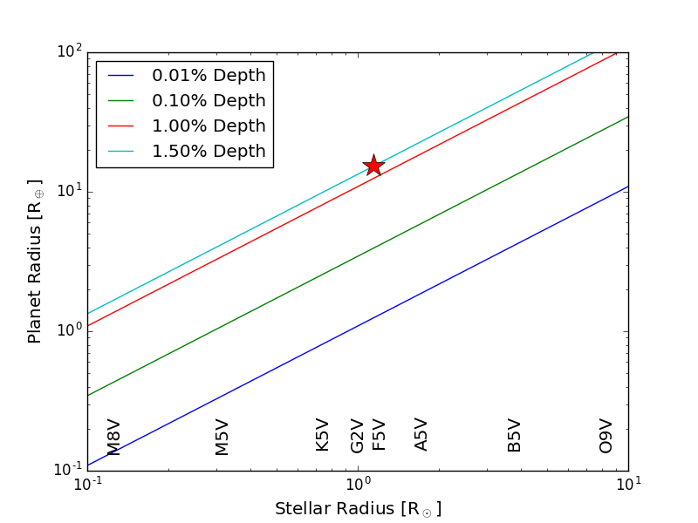
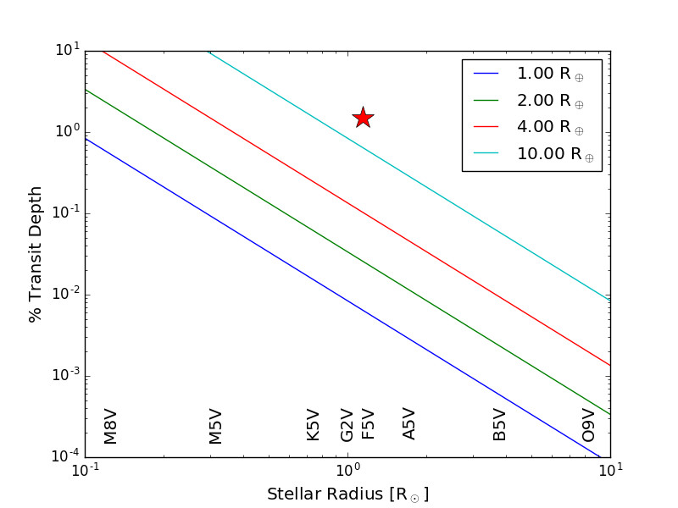
4. What combination of stellar types and planets give similar transit depths?

Slide 7
5. Why do small stars (M dwarfs) make advantageous host stars?
M - dwarfs are small, therefore the same physically sized planet transit will block a larger fraction of such a star, making a deeper transit, than for an earlier type star
Also allows for the detection of smaller planets
M - dwarfs are common (making up approximately 70 percent of all the stars in our galaxy)
more targets
But…
M dwarfs have very narrow habitable zones, close to the star (which could lead to tidal locking)

Slide 8
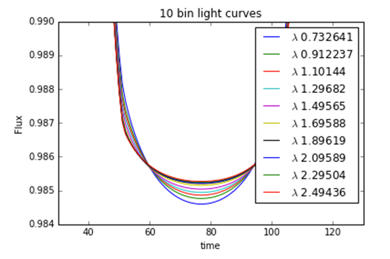
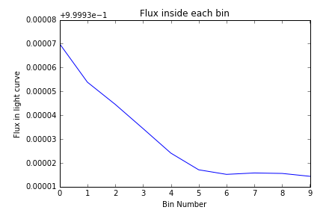
6. We consider how the light curve changes at different wavelengths
Observation wavelength affects transit depth (short is deeper), so we will see “wider” planets…
Flux appears to be redistributed, area under the curves appears to be the same (right chart)

Slide 9
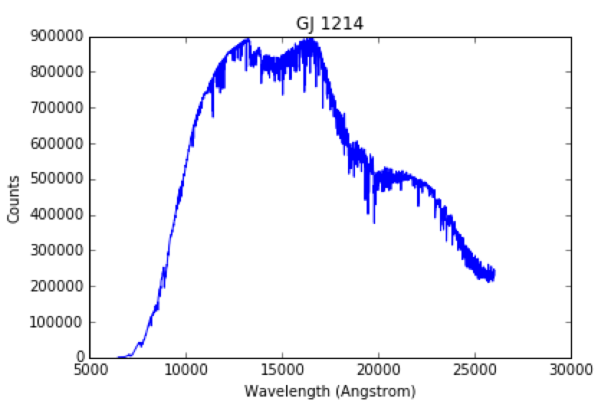
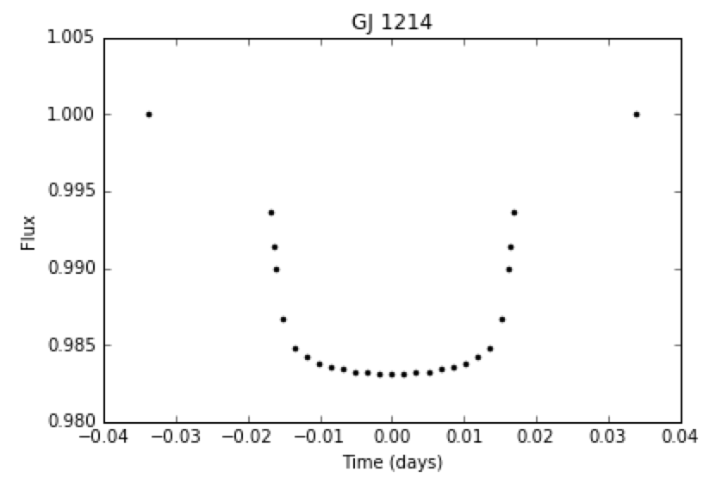
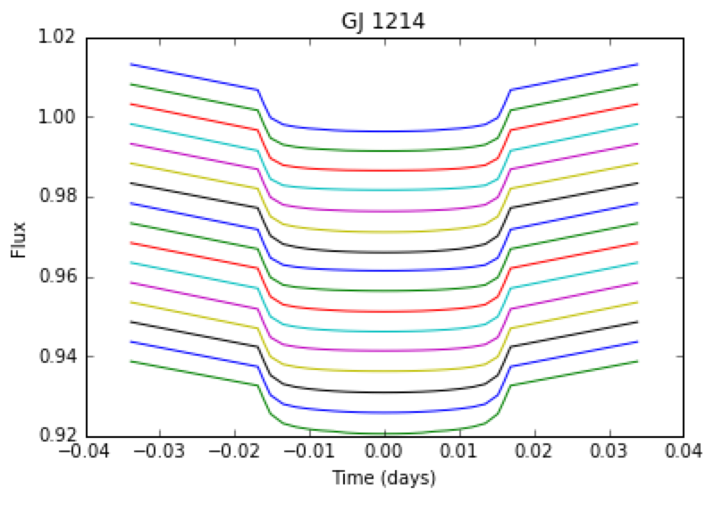
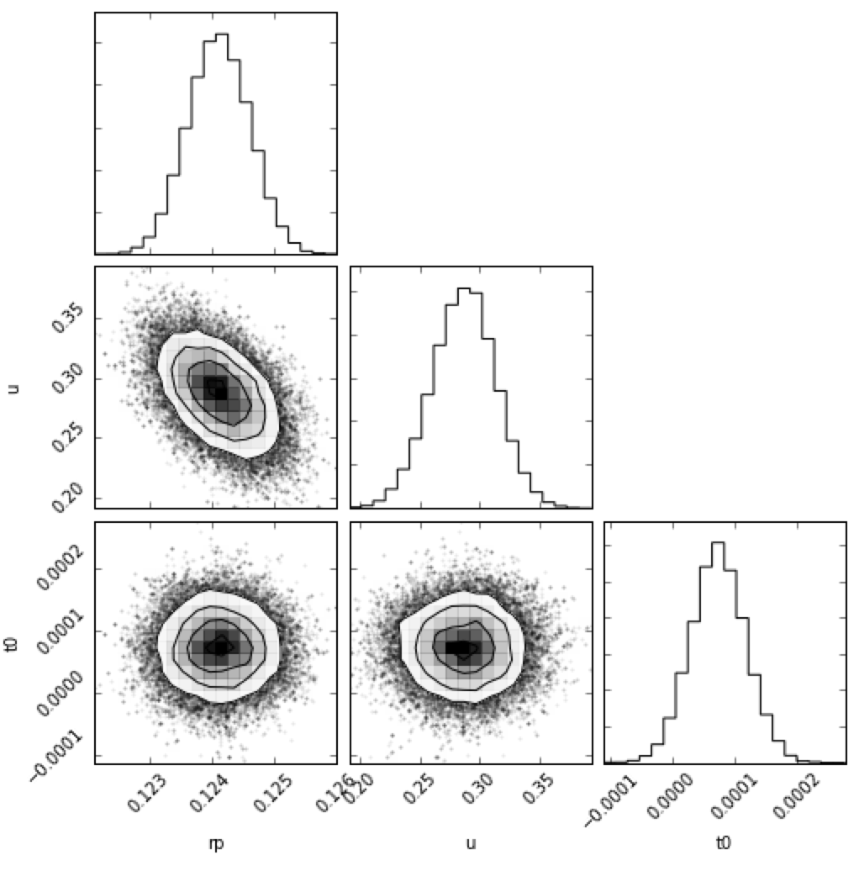
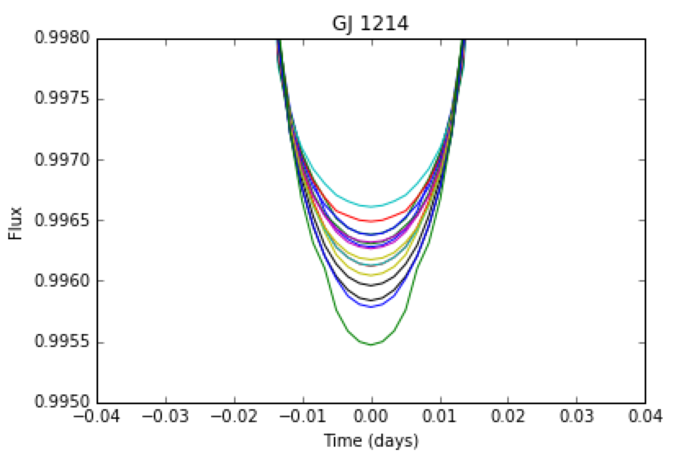
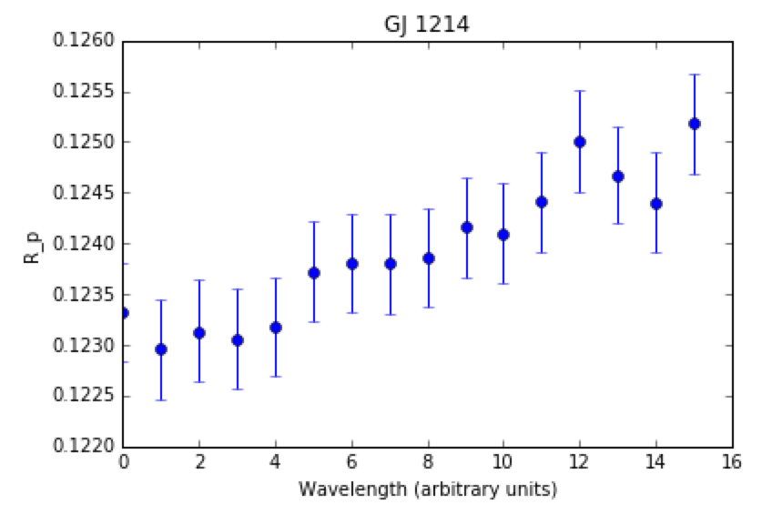
Bonus slide: Example of a Super-Earth around an M-dwarf
(missing steps)
→ Clouds!!!

Slide 10
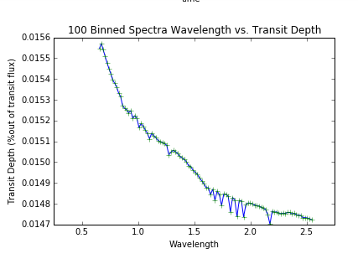
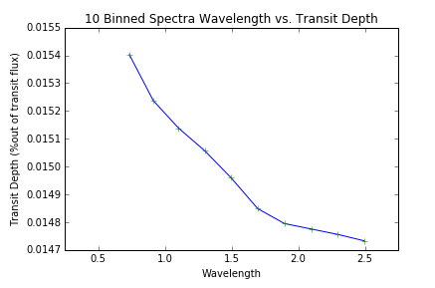
7. How does transit shape and depth change as a function of wavelength?
We binned up the spectra and looked at the transit depths by wavelength. Depth varied by approx 4% from max to min, or some 8% using the formula above for planetary radius. Woah!

Slide 11
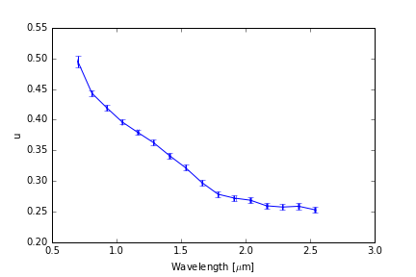
8. At which wavelengths is the limb-darkening effect strongest?
The limb darkening decreases with increasing wavelength
Using MCMC, we fitted the light curve for all 16 bins, including the limb darkening coefficient
Assume: linear limb darkening

Slide 12
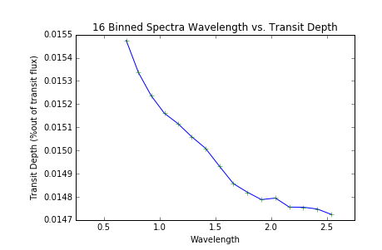
Wavelength dependence due to limb darkening?
The gradient of u is approximately 4 times transit depth gradient. Correlation analysis would be interesting. Flux being redistributed inside the star

Slide 13
Conclusions
Yes, there was a planet in our data
Taking maximum transit depth, planet radius is 12% that of its star
Assuming star is ‘typical’ G0V (from spectra) then this is 1.35 Jupiter radii so not a brown dwarf
But if star is larger or smaller in reality, then so is the planet as we’re just looking at geometry so far
Do we see an effect with wavelength? Yes, via limb darkening

Slide 14

Any Questions?

